Slide 1
Linux Desktop
https://help.ubuntu.com/stable/ubuntu-help/

Slide 2
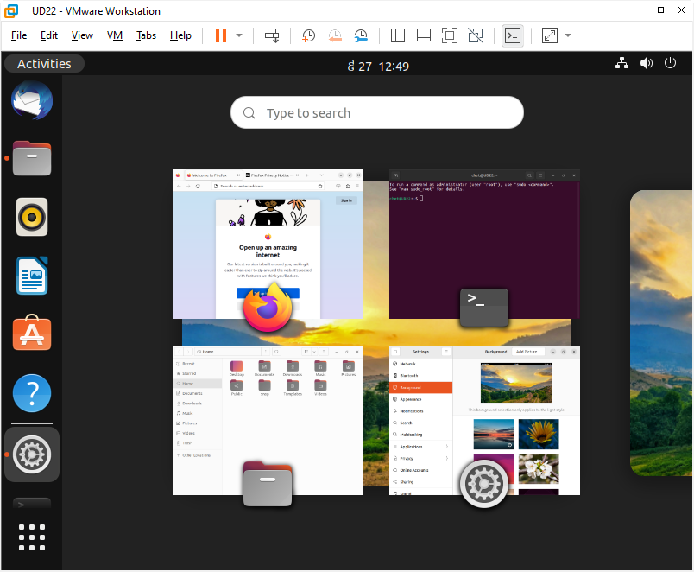
Activities/Overview

Slide 3
Similarities to Windows
Change Background
Display Settings
Listing and Switching Between Windows
Lock Screen
Log out, Power Off, or Switch User
Sound Volume

Slide 4
What do the icons in the top bar mean?
Accessibility icons
Audio icons
Battery icons
Bluetooth icons
Networking icons
Other icons
https://help.ubuntu.com/stable/ubuntu-help/status-icons.html.en

Slide 5
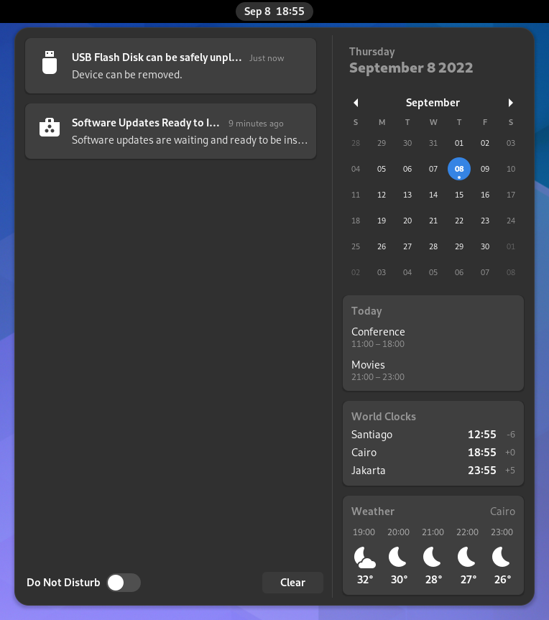
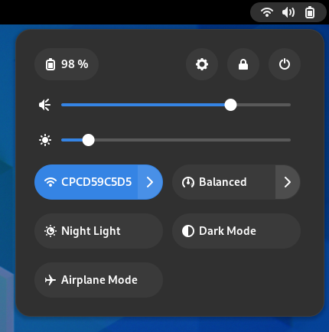
System Menu, Clock and Calendar
System Menu
Clock and Calendar
Click the system menu in the top-right corner to manage your system settings and your computer
Click the clock on the top bar to see the current date, a month-by-month calendar, a list of your upcoming appointments and new notifications.
You can also open the calendar by pressing Super+V.
You can access the date and time settings and open your full calendar application directly from the menu.

Slide 6
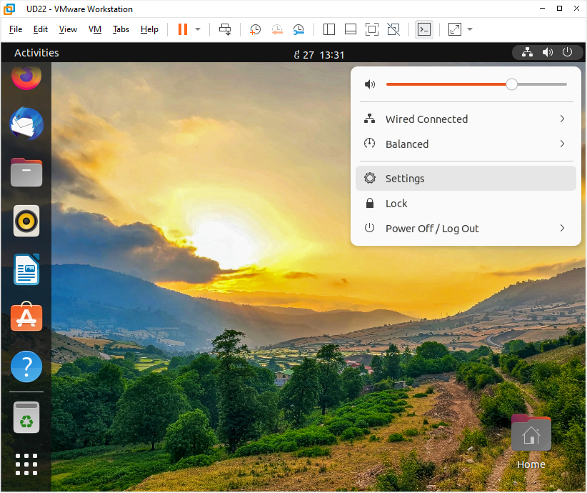
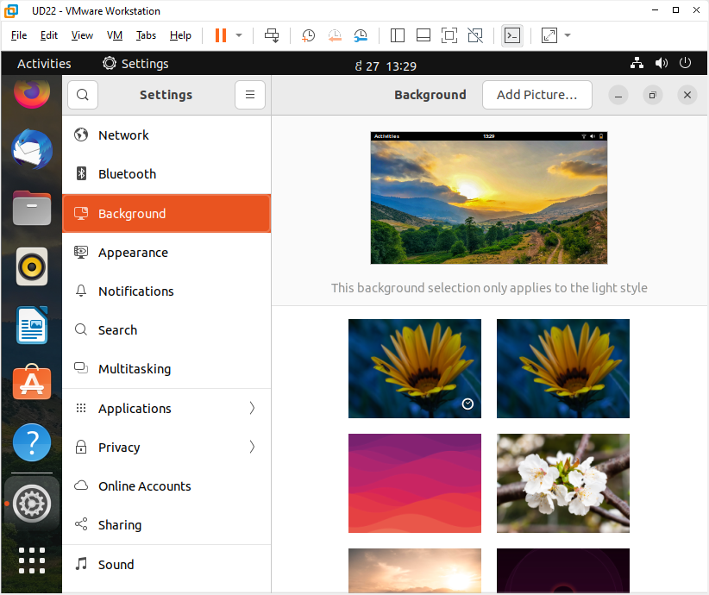
System Settings
System Menu → Select Settings

Slide 7
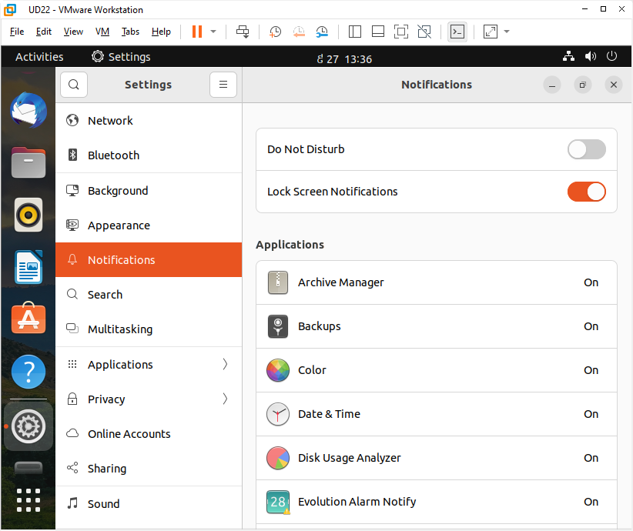
Notification Settings

Slide 8
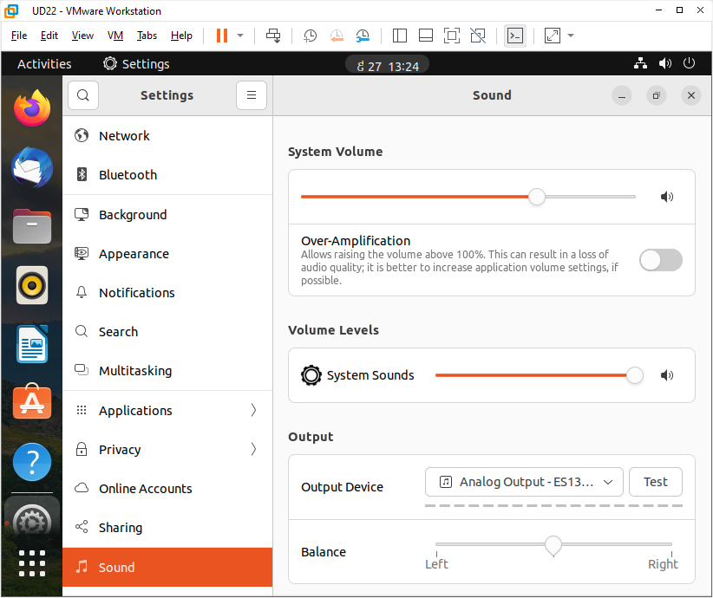
Sound Settings
Activities →Search: type “Sound”
Or: System Menu → Select Settings → Sound

Slide 9
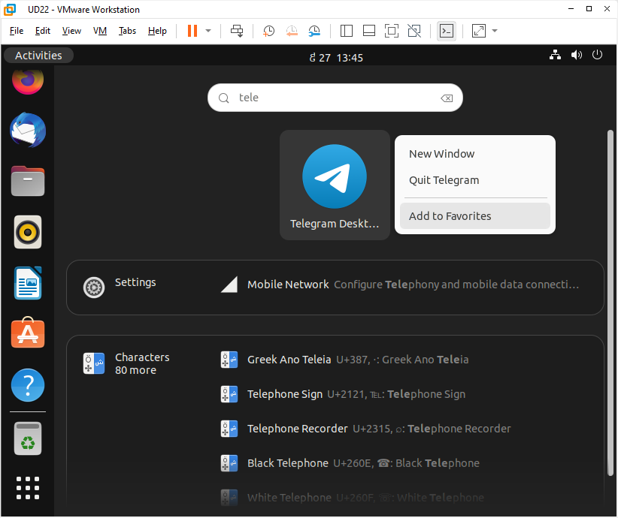
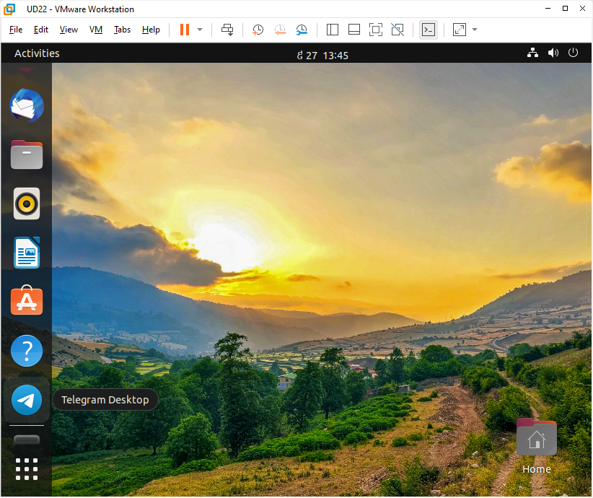
Pin your favorite apps to the dash
Click Activities → Right-click the application icon and select Add to Favorites.
Alternatively, you can click-and-drag the icon into the dash.
To remove an application icon from the dash, right-click the application icon and select Remove from Favorites.

Slide 10
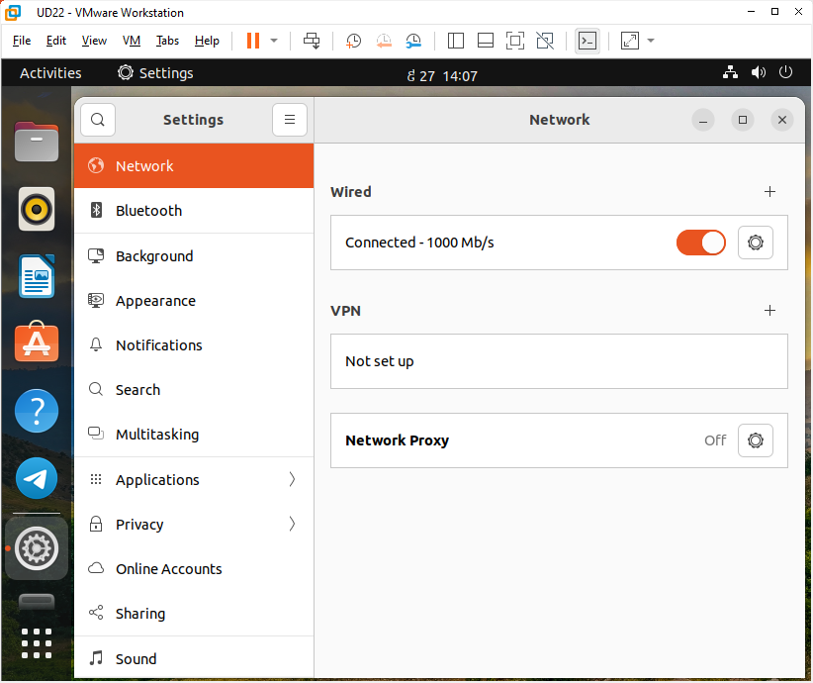
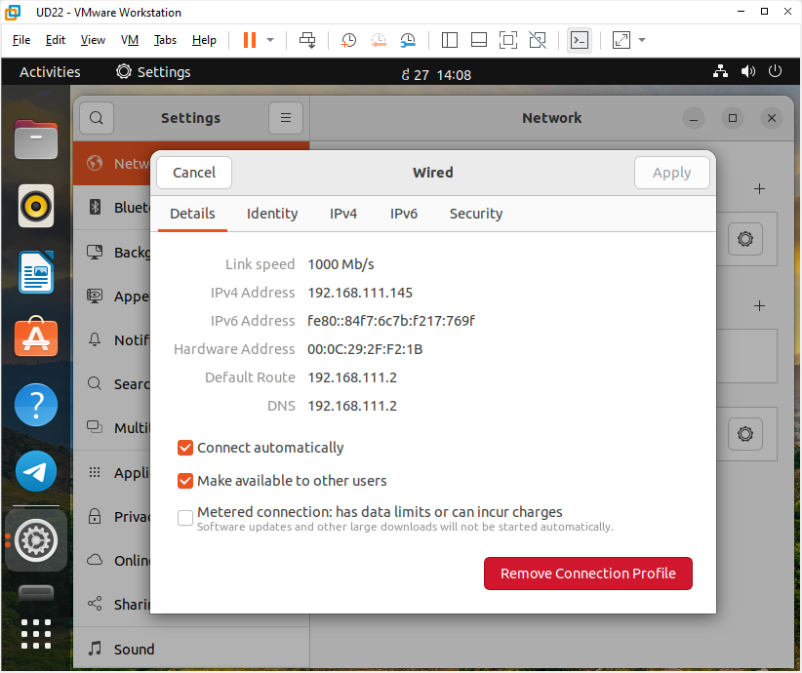
Network Settings

Slide 11
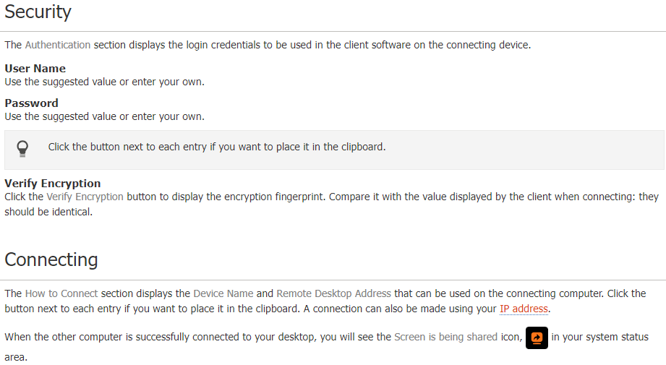
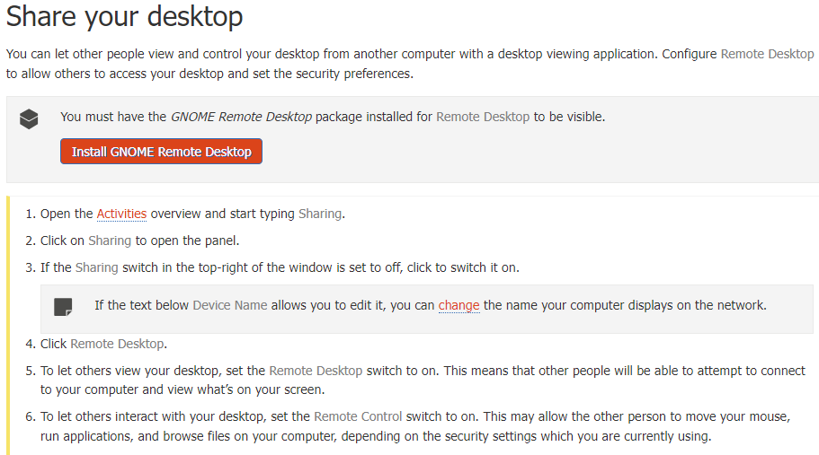
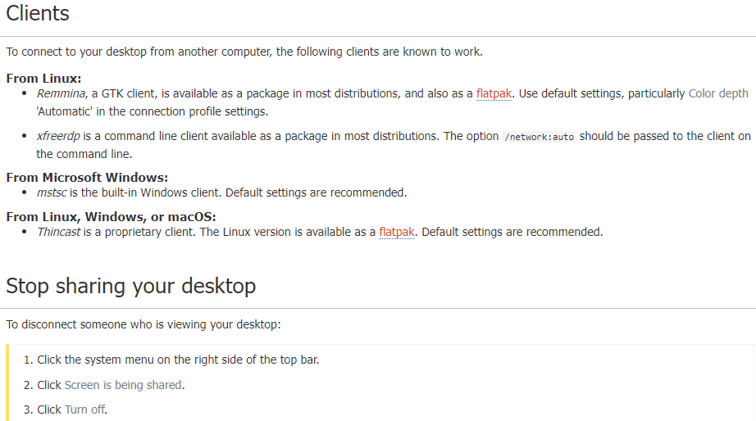
Share Your Desktop (https://help.ubuntu.com/stable/ubuntu-help/sharing-desktop.html.en)

Slide 12
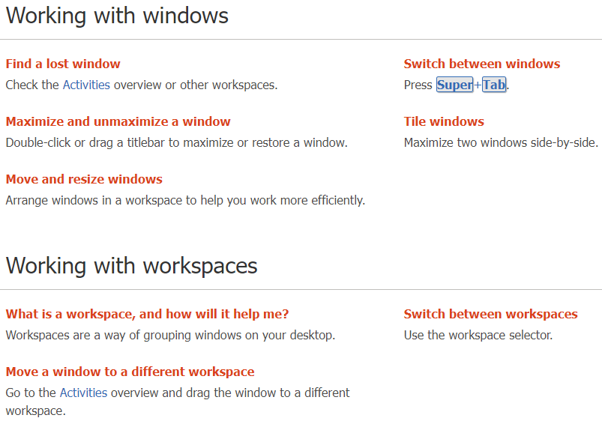
Working with Windows and Workspaces (https://help.ubuntu.com/stable/ubuntu-help/shell-windows.html.en)

Slide 13
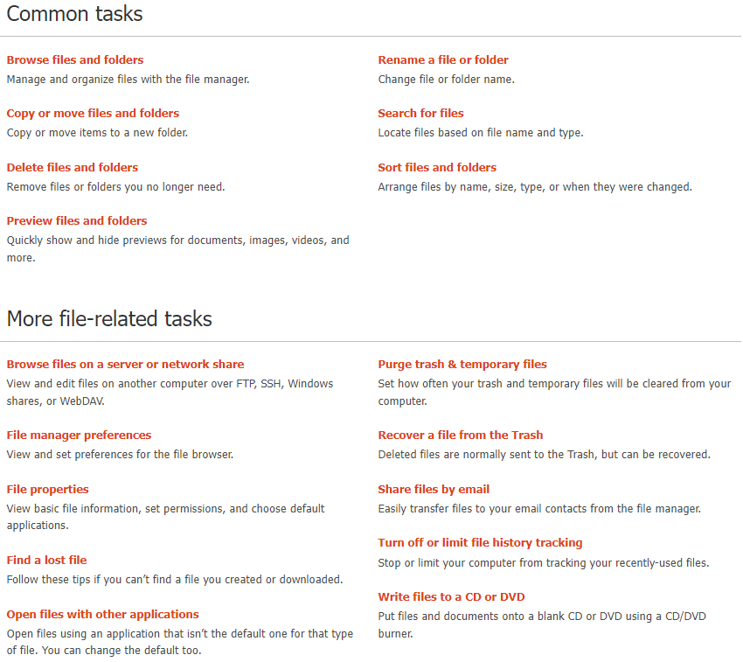
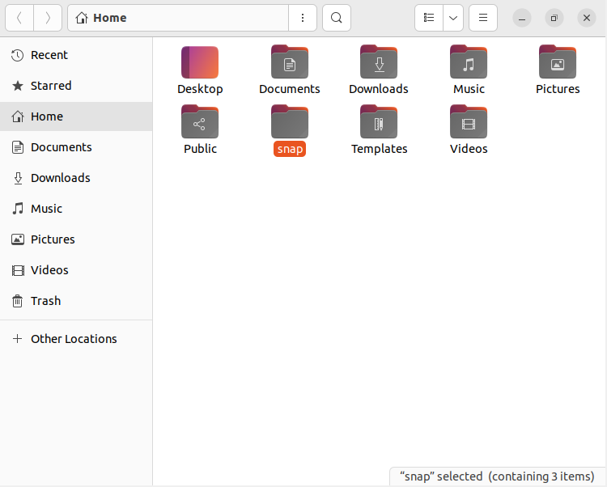
Files, Folders, and Search
https://help.ubuntu.com/stable/ubuntu-help/files.html.en

Slide 14
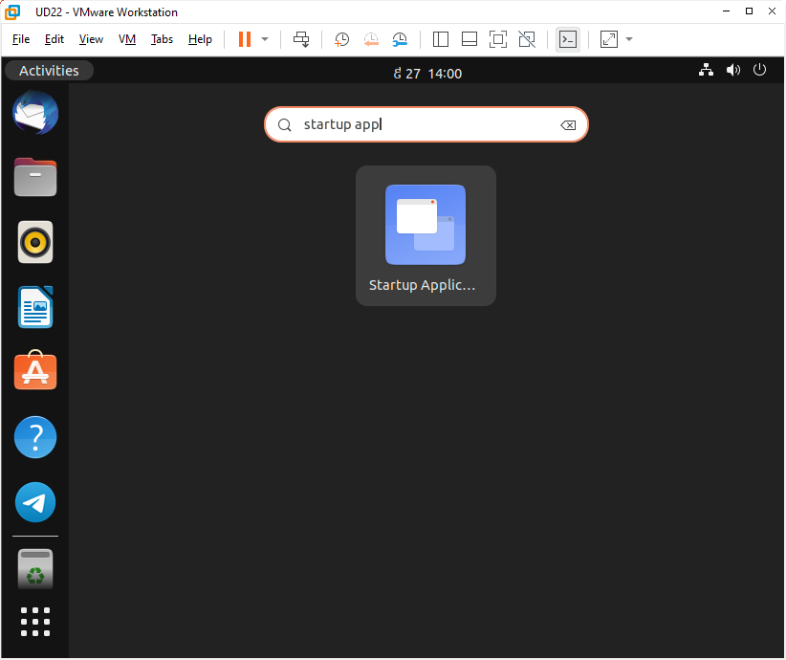
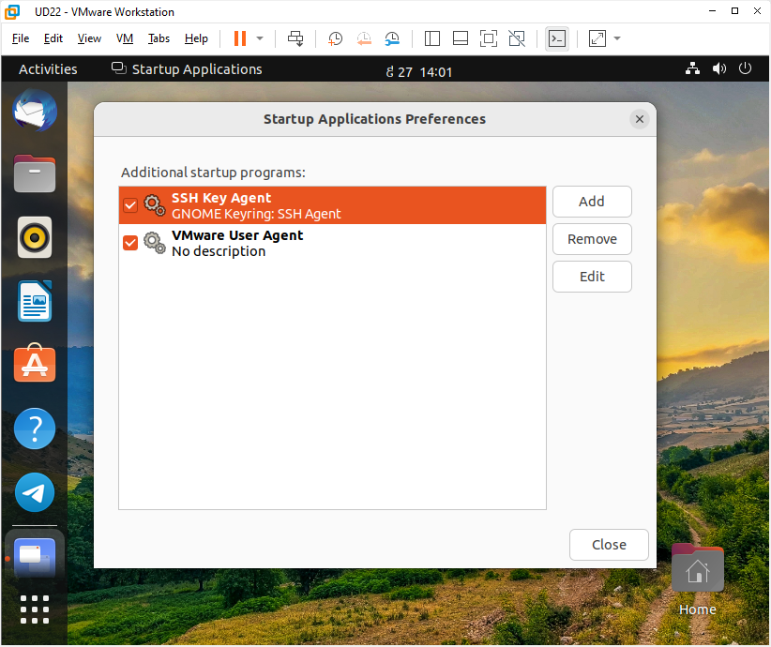
Startup Applications (https://help.ubuntu.com/stable/ubuntu-help/startup-applications.html.en)

Slide 15
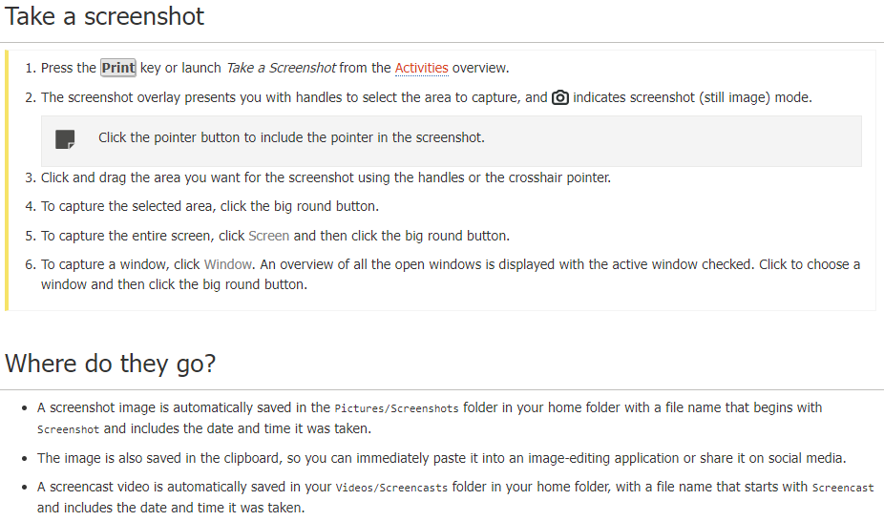

Screenshots and Screencasts (https://help.ubuntu.com/stable/ubuntu-help/screen-shot-record.html.en)

Slide 16
Do I Need Anti-Virus Software?
If you are used to Windows or Mac OS, you are probably also used to having anti-virus software running all of the time. Anti-virus software runs in the background, constantly checking for computer viruses that might find their way onto your computer and cause problems.
Anti-virus software does exist for Linux, but you probably don’t need to use it. Viruses that affect Linux are still very rare. Some argue that this is because Linux is not as widely used as other operating systems, so no one writes viruses for it. Others argue that Linux is intrinsically more secure, and security problems that viruses could make use of are fixed very quickly.
Whatever the reason, Linux viruses are so rare that you don’t really need to worry about them at the moment.
If you want to be extra-safe, or if you want to check for viruses in files that you are passing between yourself and people using Windows and Mac OS, you can still install anti-virus software. Check in the software installer or search online; a number of applications are available.

Slide 17
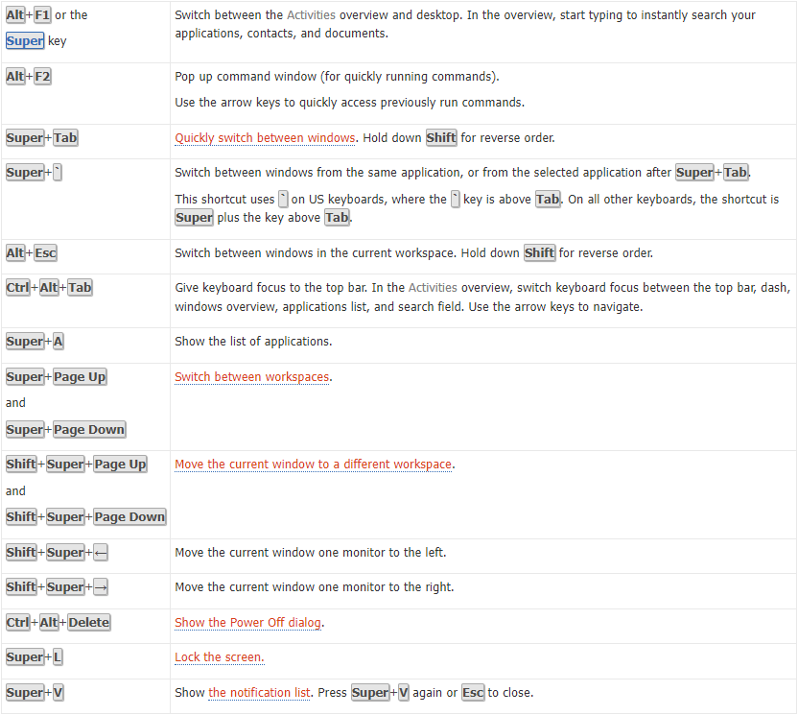
Useful keyboard shortcuts
Getting around the desktop:
(https://help.ubuntu.com/stable/ubuntu-help/shell-keyboard-shortcuts.html.en)

